Slide 1
15 – Visualizing Model Performance
Dave Eargle – CU Boulder

Slide 2
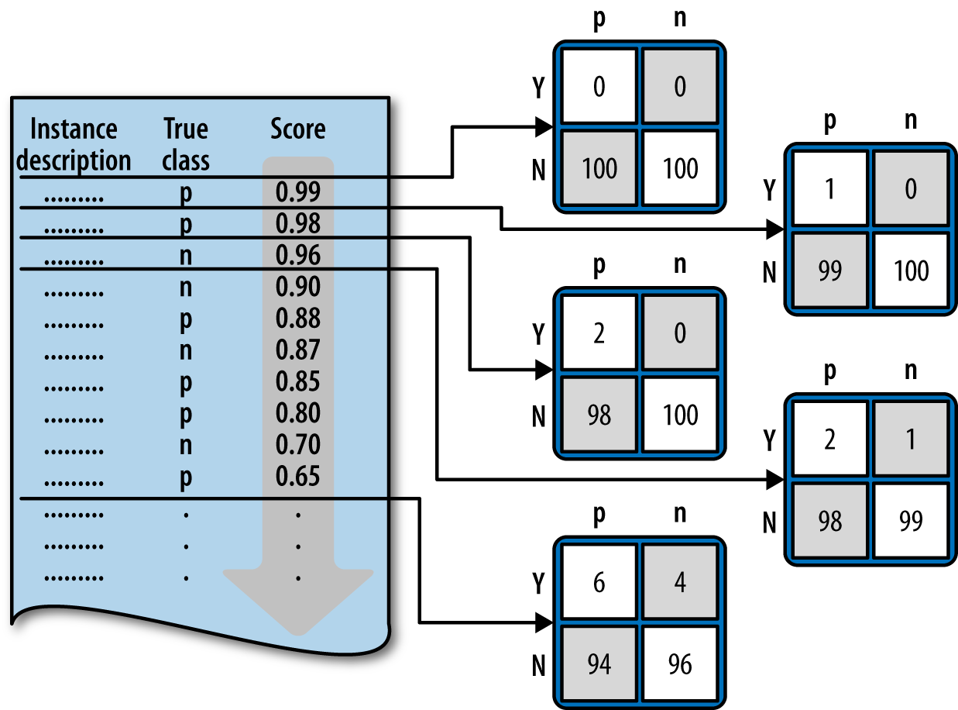
Ranking Instead of Classifying
You get one confusion matrix for every possible cutoff threshold

Slide 3
Profit Curves
Last time, we used a cost-benefit matrix to calculate expected value per customer at a single cutoff point
We did this to compare classifiers
But if you multiply that by your total group size, you get your total profit
We can calculate the expected profit at all possible cutoff thresholds, for as many classifiers as we want, and plot it.

Slide 4
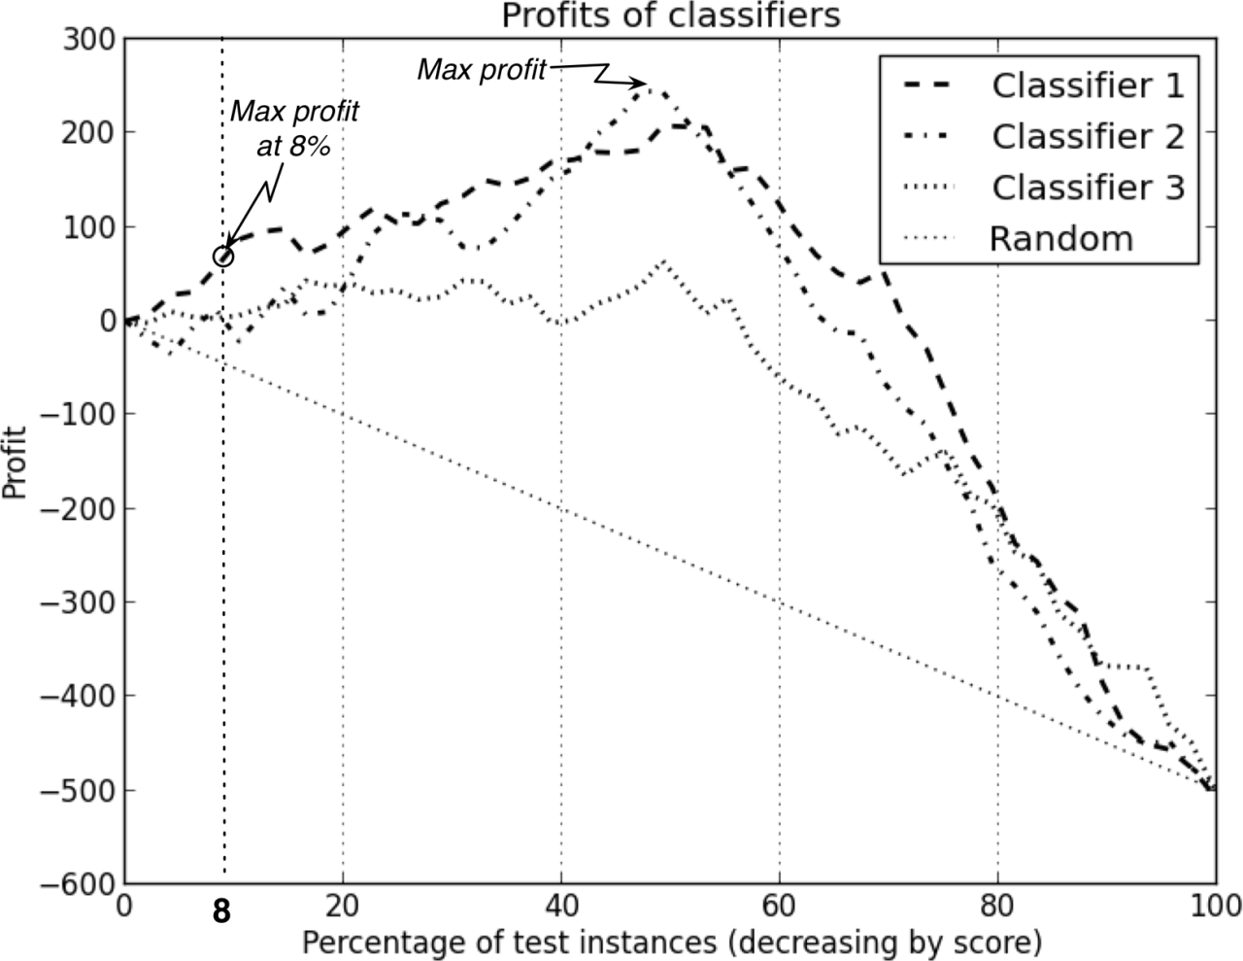
Profit Curves | Which classifier to use?
What if you have unlimited budget?
Which classifier and what percentage?
What if you only have enough budget to target 8% of your customer base?
Each classifier ranks its predictions from highest to lowest. The x axis is the percent of your customer based contacted, in descending probability order.
This means that each classifier may contact customers in a different order.
If you contact everyone, you lose money in this case!

Slide 5
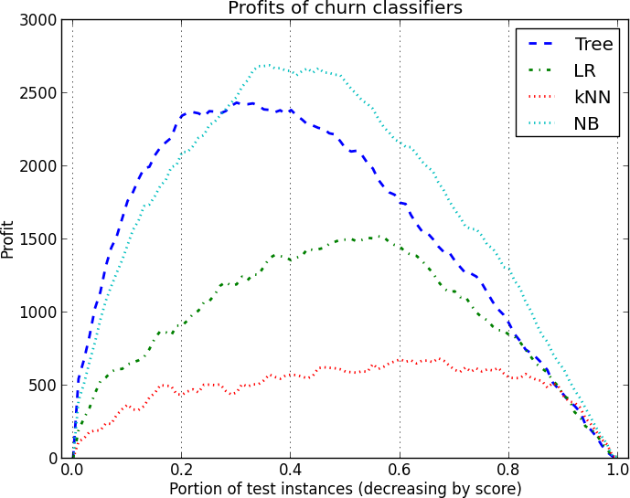
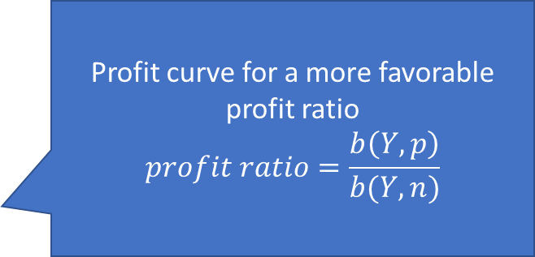
Profit Curves
Which to use and contact how many if unlimited budget?
Which to use if only sufficient budget to contact 20%?
Profit curve for a more favorable profit ratio
$$profit ratio=\frac{b\left(Y,p\right)}{b(Y,n)}$$

Slide 6
Profit Curves
Just as with the Expected Value Framework, there are two critical conditions underlying the profit calculation:
The class priors
The proportion of positive and negative instances in the target population
The costs and benefits
The expected profit is specifically sensitive to the relative levels of costs and benefits for the different cells of the cost-benefit matrix

Slide 7
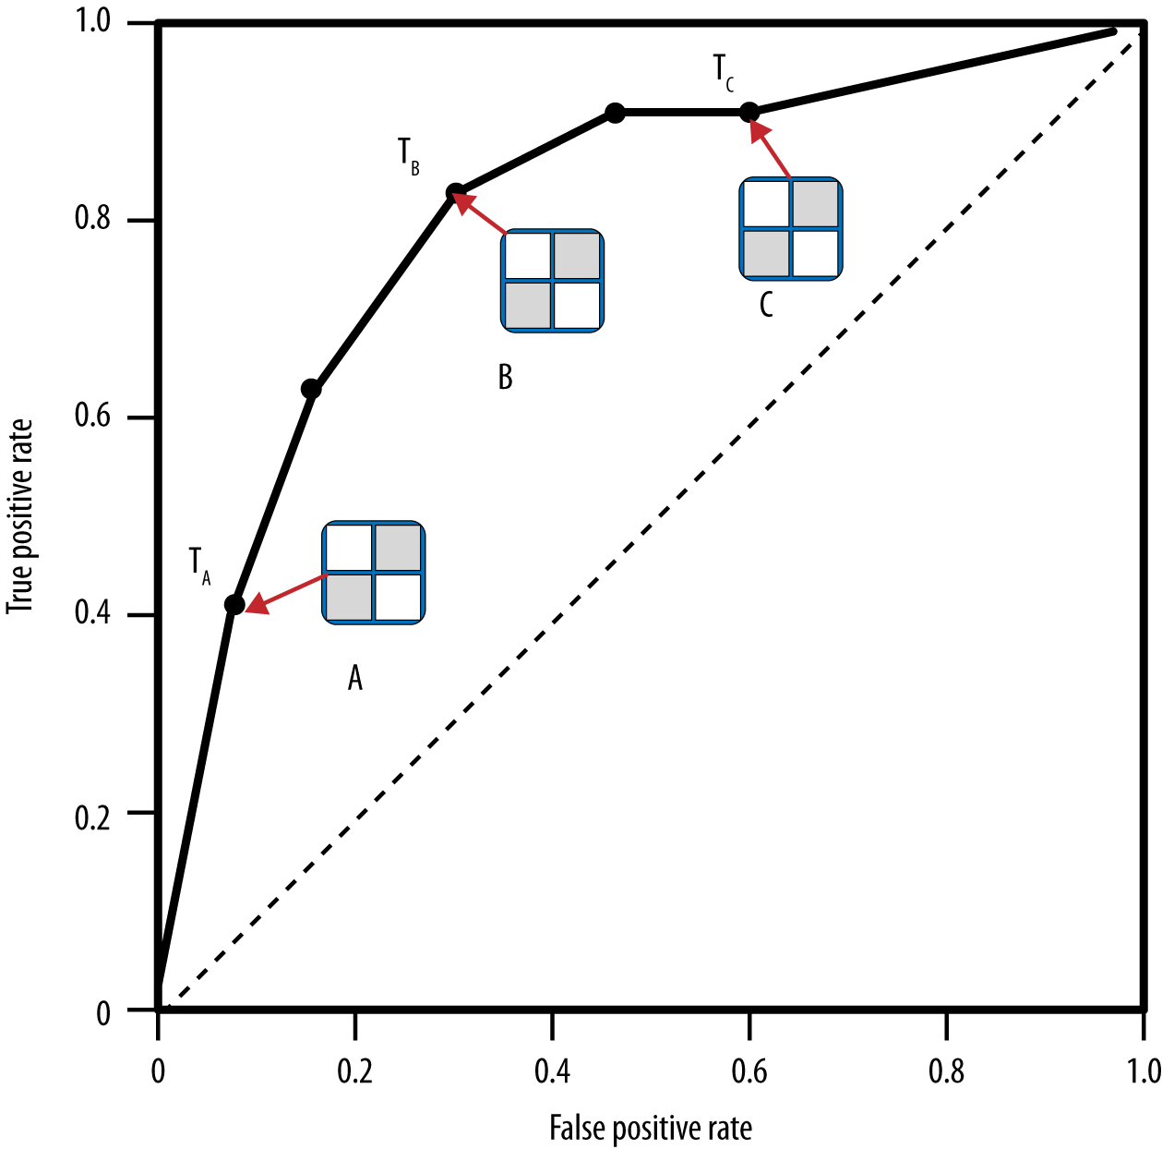
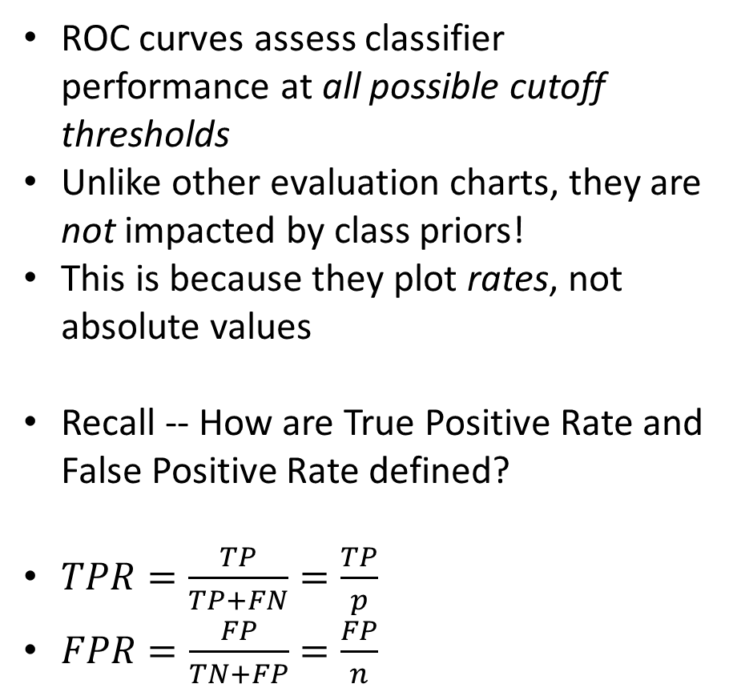
ROC Graphs and Curves
Where would the point be for the ‘perfect’ classifier?
ROC curves assess classifier performance at all possible cutoff thresholds
Unlike other evaluation charts, they are not impacted by class priors!
This is because they plot rates, not absolute values
Recall -- How are True Positive Rate and False Positive Rate defined?
$TPR=\frac{TP}{TP+FN}=\frac{TP}{p}$
$FPR=\frac{FP}{TN+FP}=\frac{FP}{n}$

Slide 8
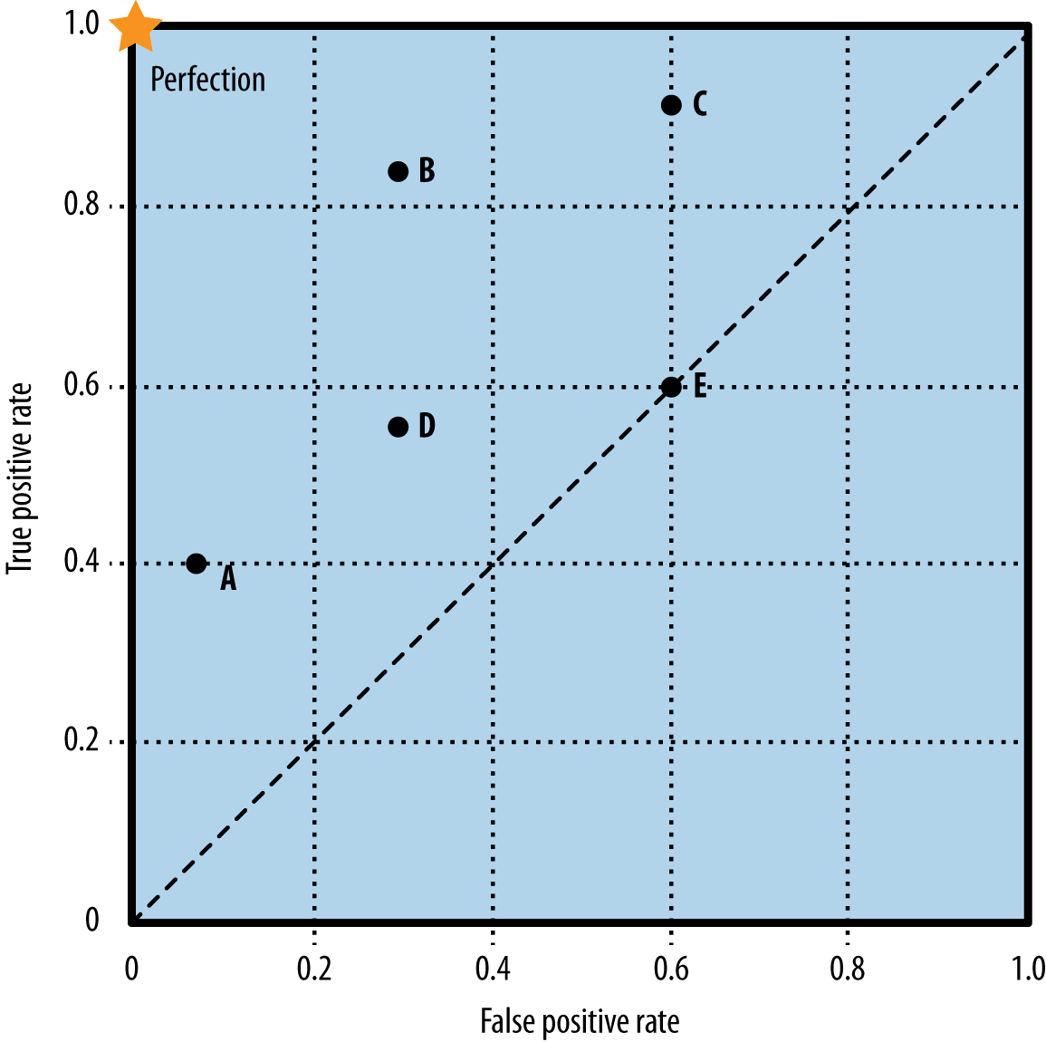

ROC Graphs and Curves
If a classifier has no ability to distinguish between TP and TN, its performance will fall along the diagonal for all possible cutoff thresholds. No better than random guessing with different proportion of “yes” and “no” guesses.
ROC curves assess classifier performance at all possible cutoff thresholds
Unlike other evaluation charts, they are not impacted by class priors!
This is because they plot rates, not absolute values
Quick! How are True Positive Rate and False Positive Rate defined?
$TPR=\frac{TP}{TP+FN}=\frac{TP}{p}$
$FPR=\frac{FP}{TN+FP}=\frac{FP}{n}$
A classifier that just did a coin-flip would fall right at the .5, .5 point.
Which is better, Point A or Point C?
Depends on your relative costs and benefits for different kinds of correct predictions and errors.

Slide 9
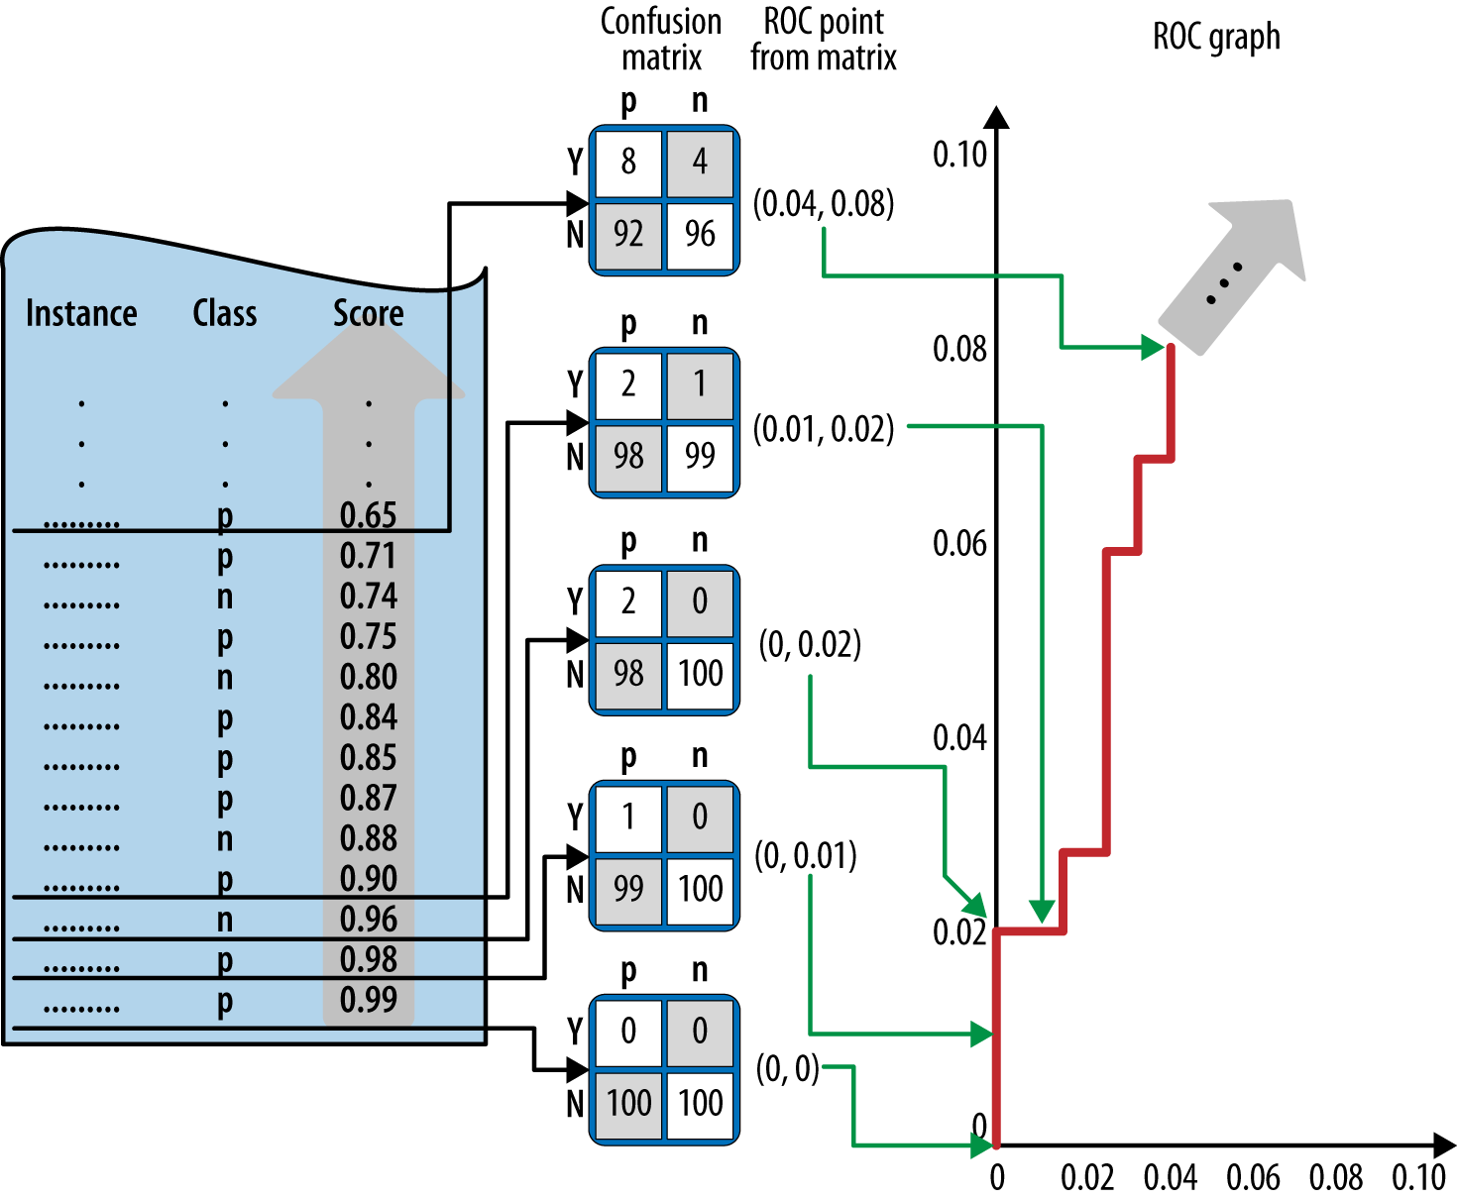
ROC Graphs and Curves
ROC curve creation algorithm
Sort the test set by the model predictions
Start with cutoff = max (prediction)
Decrease cutoff, after each step count the number of true positives TP (positives with prediction above the cutoff) and false positives FP (negatives above the cutoff)
Calculate TP rate (TP/P) and FP (FP/N) rate
Plot current number of TP/P as a function of current FP/N

Slide 10
ROC Graphs and Curves
ROC graphs decouple classifier performance from the conditions under which the classifiers will be used
ROC graphs are independent of the class proportions as well as the costs and benefits
But… not the most intuitive visualization for many business stakeholders
!!!!

Slide 11
Area Under the ROC Curve (AUC)
The area under a classifier’s curve expressed as a fraction of the unit square
Its value ranges from zero to one
The AUC is useful when a single number is needed to summarize performance, or when nothing is known about the operating conditions (e.g., cost-benefit matrix is unknown)
A ROC curve provides more information than its AUC
AUC is also called the Mann-Whitney-Wilcoxon measure
Also equivalent to the Gini Coefficient (with a minor algebraic transformation)
Both are equivalent to the probability that a randomly chosen positive instance (TP) will be ranked ahead of a randomly chosen negative instance (FP)

Slide 12
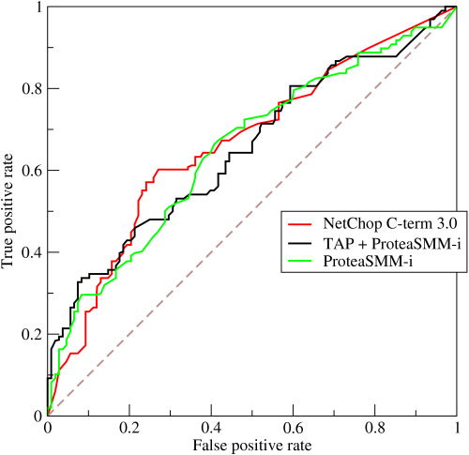
Multiple classifiers on one ROC curve chart
Overall, which classifier is better? Why?

Slide 13
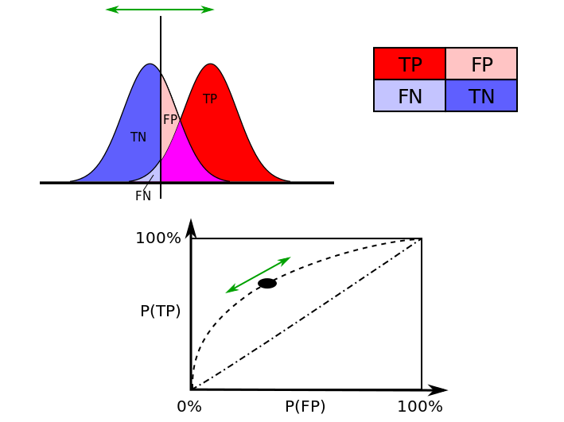
Density plots of true p’s and n’s grouped by a classifier’s probability estimation of them.
The more separated the probability means are for the p’s and n’s, the better the classifier.
As the vertical classification cutoff threshold bar moves, the point moves along the ROC curve in opposite direction
Interactive ROC curve: http://arogozhnikov.github.io/2015/10/05/roc-curve.html

Slide 14
Alternatives to ROC curve
Cumulative Response Curve
Lift Curve

Slide 15
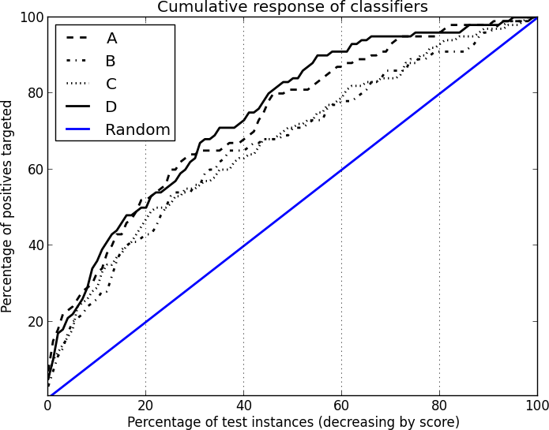
Cumulative Response curve
More intuitive to management and stakeholders than ROC curves
However, if the priors in the training data do not match the population to which the model will be applied, the relationship between the values on the axes are not valid. But the overall shape can be informative.
Remember, ROC curves are independent of class priors.

Slide 16
Wait, why does this figure depend on class priors?
If your training data has a 50-50 p-n split, and if you have a perfect classifier, you only need to target half of your population in order to get all p’s
This would be a point at (.50, 1) on the curve
If there's a 75-25 p-n split, and you have a perfect classifier, then you need to contact 75% of your population before you get all p’s
This would be a point at (.75, 1) on the curve
Therefore, the points (and therefore the curves) depend on class priors

Slide 17
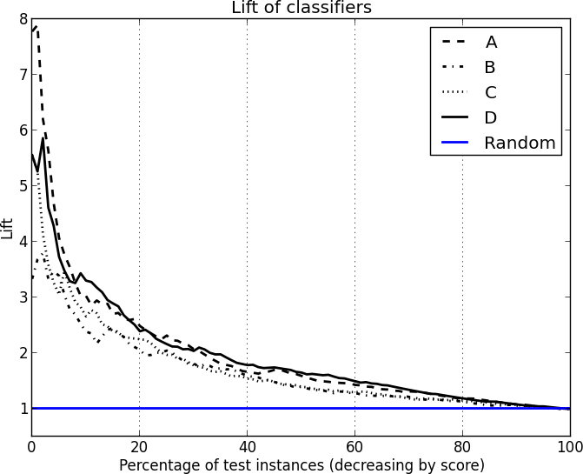
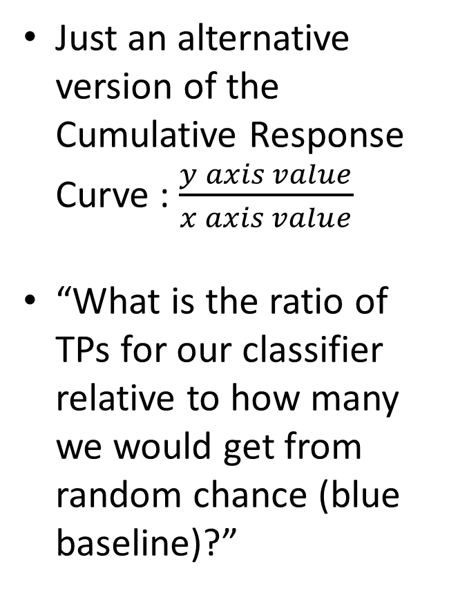
Lift Curve
Just an alternative version of the Cumulative Response Curve : $\frac{y axis value}{x axis value}$
“What is the ratio of TPs for our classifier relative to how many we would get from random chance (blue baseline)?”

Slide 18
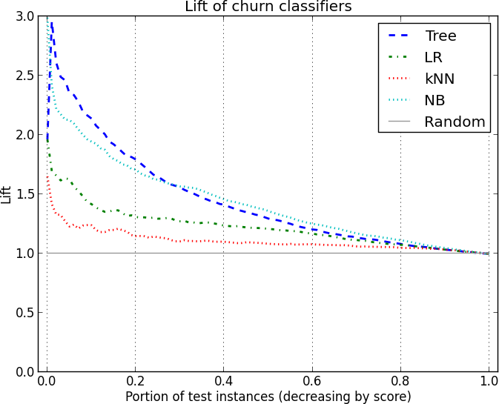
Lift Curve
If you can target 20% of your customer base, which classifier would you choose? How about for 50%?

Slide 19
Let’s look at it on Data Robot
Data: Lending Club No Target Leak
DataRobot chooses the ROC curve threshold that maximizes the F-1 score
https://en.wikipedia.org/wiki/F1_score
Generally speaking, F1-score favors good performance with positive predictions (combination of precision and recall, https://en.wikipedia.org/wiki/Precision_and_recall )
Lift chart
DR’s interpretation is different from ours!
Model comparison

Slide 20
Challenge question – how can you choose the best threshold? What if it’s not .50?
Score your data so that you have `actual` and `probabilities`
Make a binary prediction based on a threshold – reference the threshold in another cell
Use IF logic to flag whether each prediction is correct or not
Alternatively, for other metrics, use AND() logic to determine whether each prediction is a TP, TN, FP, FN
Calculate accuracy over all of your predictions
Now create a range of thresholds in a column (e.g., 0.05 through 0.95)
Excel > Data tab > “What-If Analysis” > Data Tables
See video recording for how to use
Example workbook: https://canvas.colorado.edu/files/1040316/download?download_frd=1
Consider choosing the threshold with the maximum accuracy (or whatever other metric you desire).
Although generally, .5 is best for accuracy (not necessarily for other metrics!)

Slide 21
Many figures in this slide deck from Provost, F., & Fawcett, T. (2013). Data science for business: what you need to know about data mining and data-analytic thinking. Sebastopol, Calif.: O'Reilly.

